Slide 1
Nuestro Proyecto
(we also call ourselves the bean bag bois)
Conor Logsdon, Kevin Wilke, and Jonathan Kohler

Slide 2
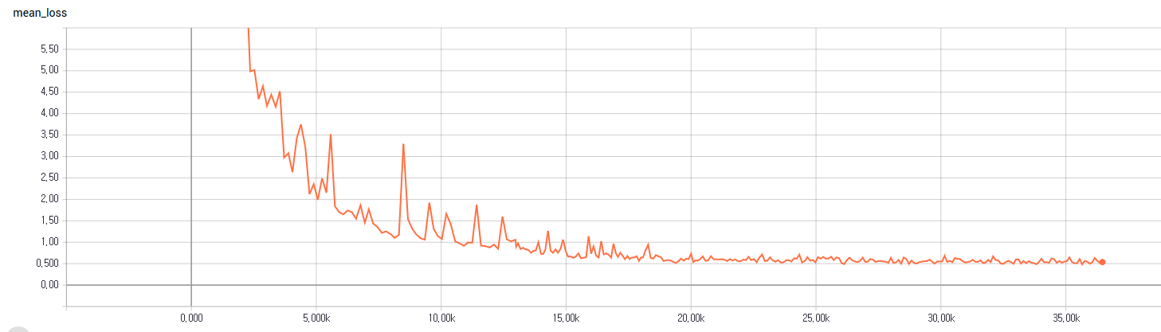
Mean Loss

Slide 3
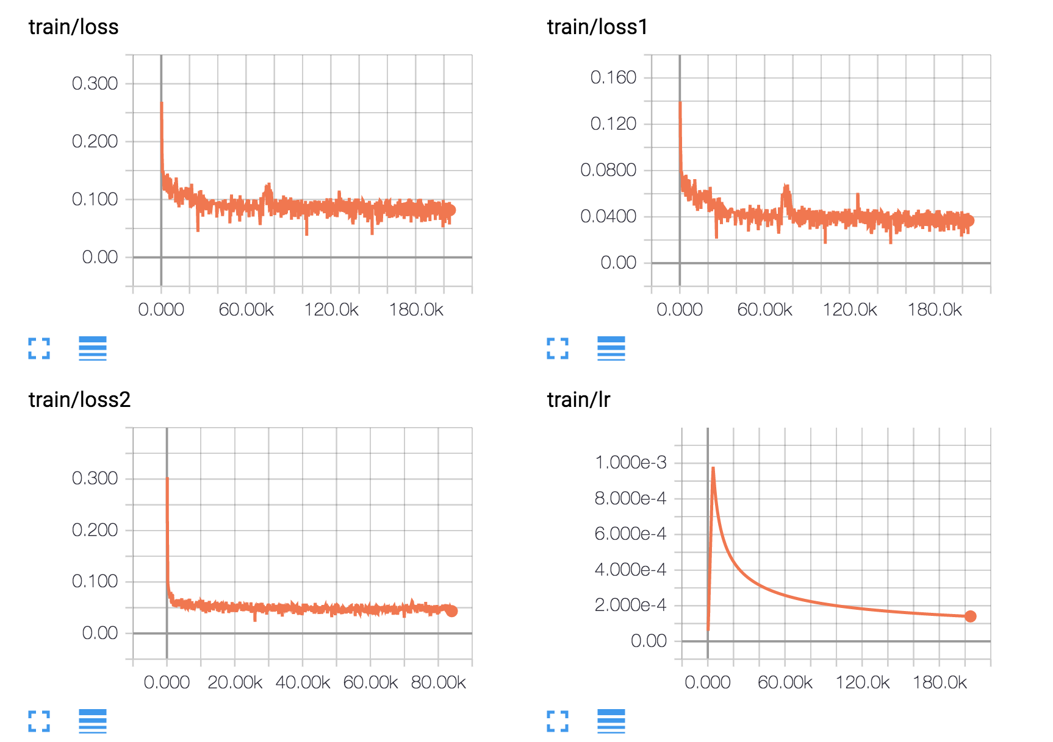

Slide 4
Jarvis
What is Jarvis?
It is an A.I. Assistant made to help you with general tasks like opening applications.
How does Jarvis work?
Jarvis uses speech recognition to execute commands from its user.

Slide 5
Commands ( functioning)
Open Steam
Open Blizzard
Open command prompt
Tell me a joke
Play chess
Whats up
Print Screen

Slide 6
Commands ( functioning)
Put computer to sleep
Open youtube
Open website
Tell me a joke
Close program
Turn computer off
Send email

